Slide 1

Smart Gen-Home

Slide 2






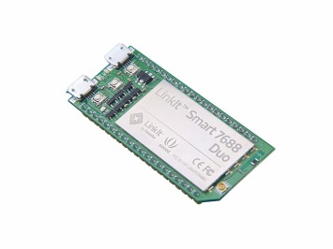
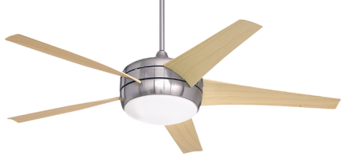
Block Diagram
CLOUD
(thingspeak.com)
Send
Data
Receive
Data
Receive
Data
Send
Data
Mobile
Application
Sensors
Microcontroller + WiFi
(Linkit Smart 7688 Duo)
DEVICES

Slide 3
Hardware Used:
Linkit smart 7688 duo
Relays
Power Supply
Devices ( Fan , light , motor etc.)
Sensors
Connection wires

Slide 4
Software Used:
Arduino IDE (programming)
MIT App Inventor ( app development)
Putty (configuring Linkit Smart 7688 duo)
Thingspeak.com as the cloud platform

Slide 5

Linkit Smart 7688 Duo
Media Tek MT7688 and ATmega 32U4
Co-design by Seeed and MTK
In-built Wifi facility
Memory expansion through micro SD card.
Arduino compatible

Slide 6
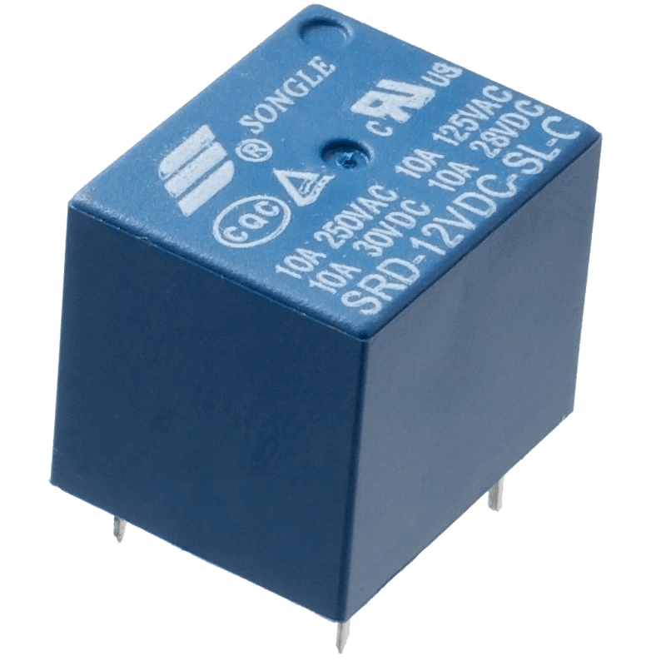
Relays:
A relay is an electrically operated switch.
Most of the relays use an electromagnet to mechanically operate a switch.
Relays are used where it is necessary to control a circuit by a separate low-power signal, or where several circuits must be controlled by one signal

Slide 7

MIT App inventor:
MIT App Inventor for Android is an open-source web application originally provided by Google, and now maintained by the Massachusetts Institute of Technology (MIT).
Drag and Drop Programming Concept.

Slide 8
Mini Weather Station
DHT11 as Temperature and Humidity sensor.
The values of Temperature and humidity are updates once every 15 sec.
The Temperature and humidity of the room can be viewed on the app anywhere and anytime.

Slide 9
HOME SECURITY Pushing Box
PushingBox is a cloud that can send notifications based on API calls. They call these notifications as “Scenarios”. By configuring the scenarios we are able to send custom notifications.
From one HTTP request, you can send several notifications like a Push, a Tweet, an Email.
Example: the DHT11 mentioned in the previous slide can be used as the fire sensor and an alert email can be sent via pushing box.

Slide 10
HOME SECURITY
Enable mjpg streamer .
Take a snapshot of anyone entering the door by using the url http://192.168.1.x:portnumber/?action=snapshot
To make the local IP address accessible to pushing box by using port forwarding. Pushing box can now access the above taken picture by external IP address.
To configure the Scenarios in pushing box to send us email using picture URL.
Picture URL http://(external_ip):portnumber/?action=snapshot

Slide 11
THE END
THANK YOU

